Slide 1
Nuclear Challenges in Fusion Reactor Design
Michael Loughlin
Central Integration Office

Slide 2
Fission vs Fusion
Fission | Fusion
Reactor Physics | Plasma Physics
- | Vacuum
- | Magnetic fields
- | Cryogenics
Water Cooling | Water Cooling
Criticality | -
Fission Products | Tritium
 | Additional Heating
Diagnostics | Diagnostics
Radiation Damage | Radiation Damage
Waste | Waste

Slide 3
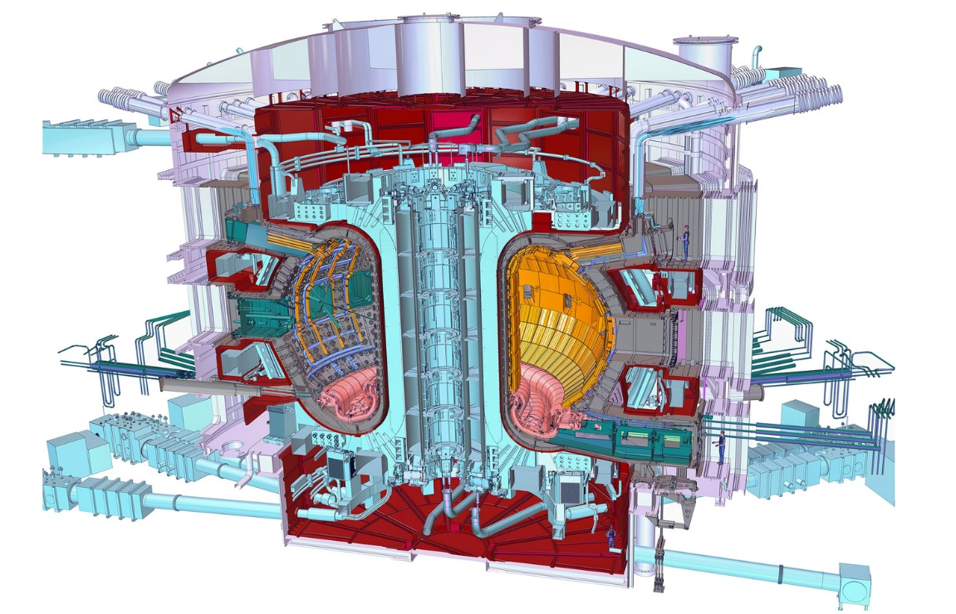
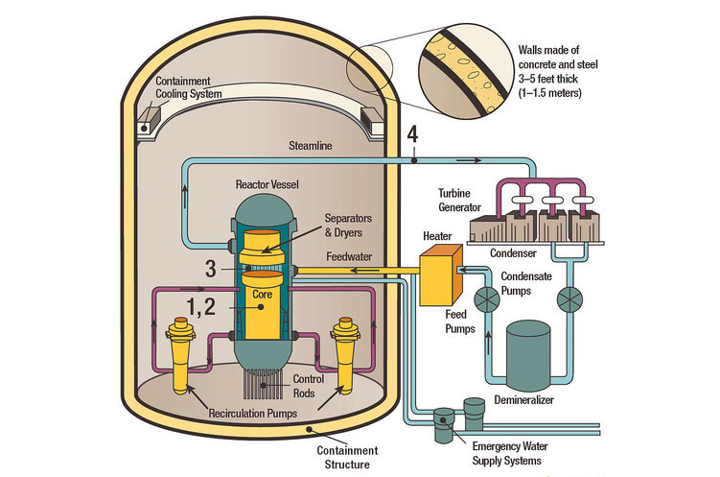
Fission & Fusion

Slide 4
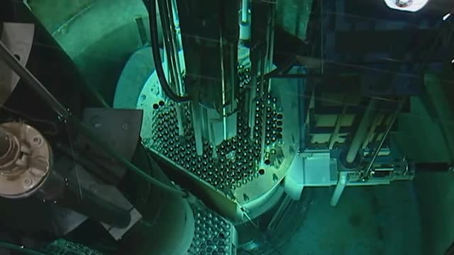
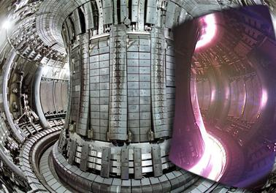
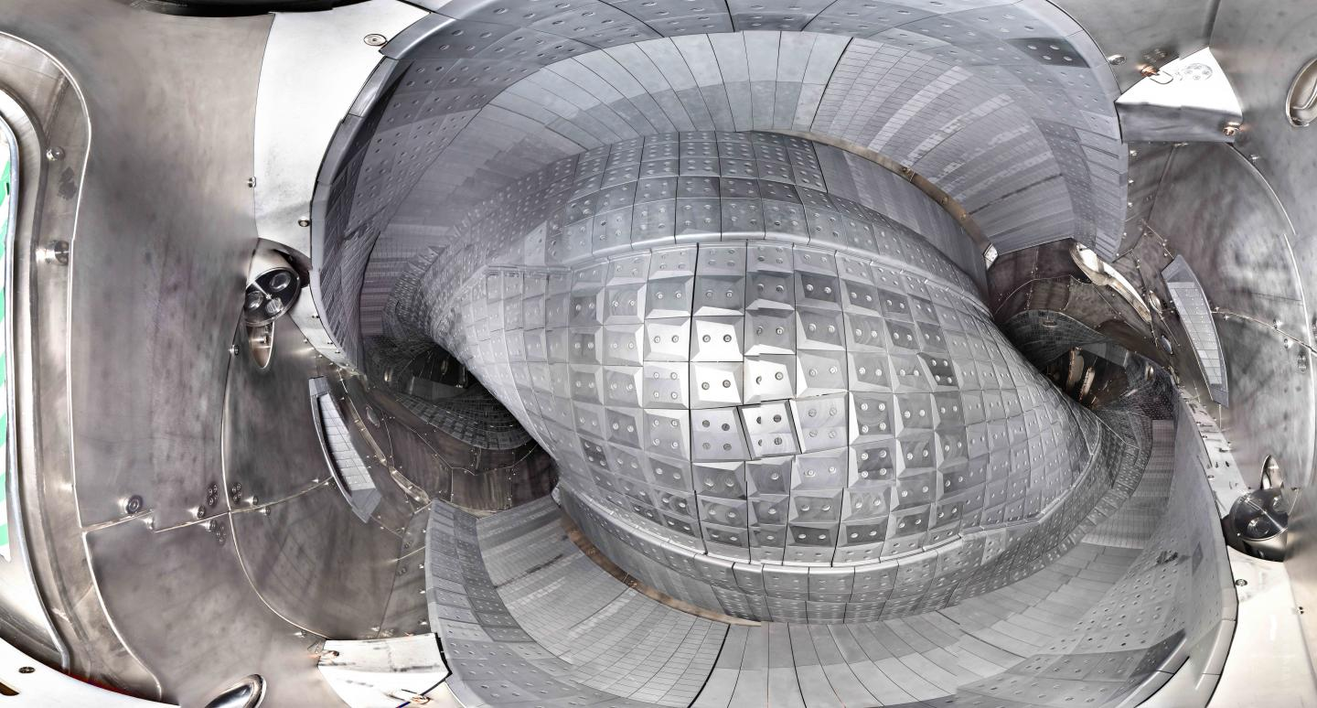
Reactor Cores
Image copyright is held by EFDA-JET.

Slide 5
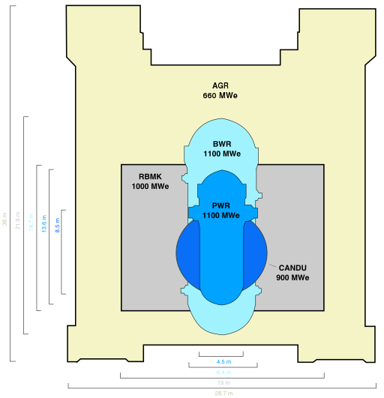
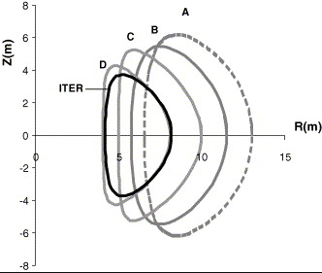
Reactor Size
By Original:antoine fleitzVector:Doanri - Own work based on: Gen II nuclear reactor vessels sizes.png, CC BY-SA 4.0, https://commons.wikimedia.org/w/index.php?curid=59264768
Copyright © 2005 David Maisonnier. Published by Elsevier B.V.

Slide 6
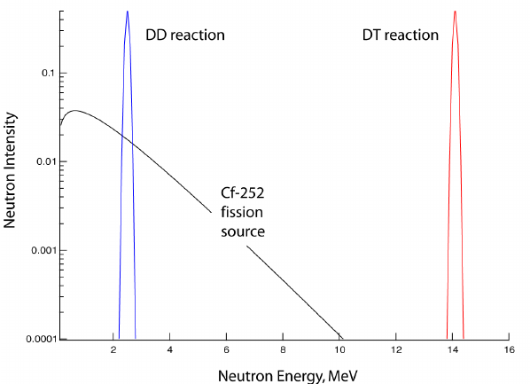
Neutron Energy

Slide 7
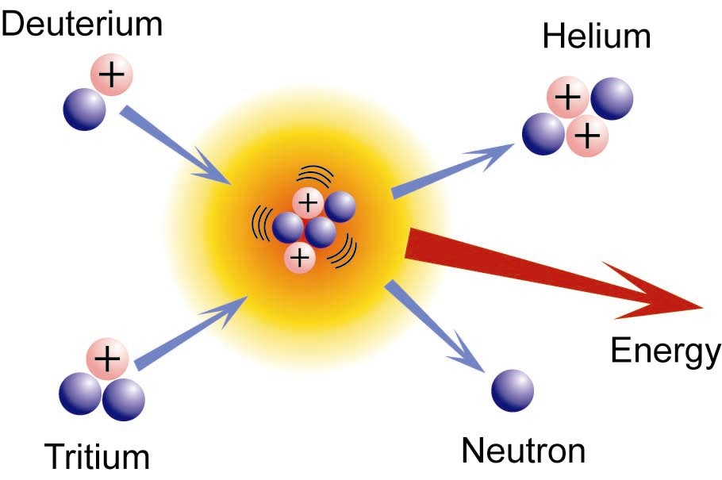
Neutron Sources
D-D
T-T
Be(H,n)
Be(He,n)
Runaway electrons
NBI
Etc…

Slide 8
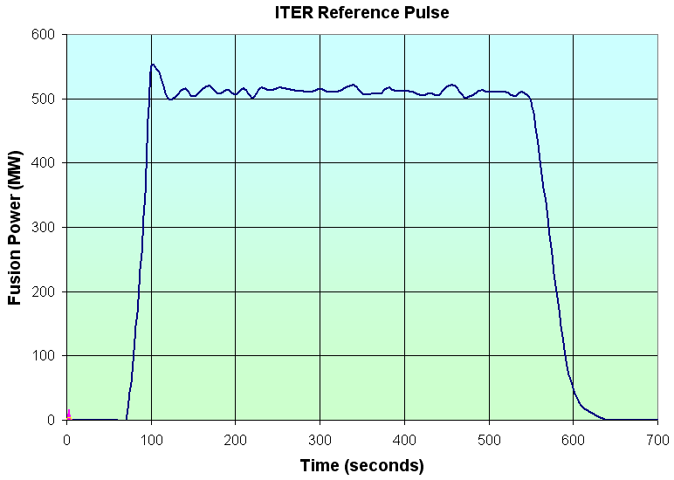
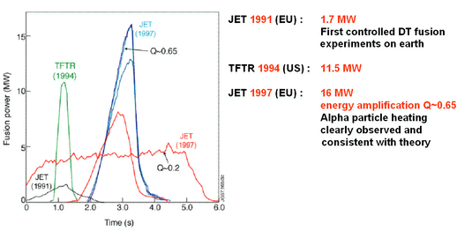
Fusion Power Production
The huge leap in neutron production in fusion experiments means that extensive nuclear analysis is required for ITER at an unprecedented level.
  level of detail required.
  the variety of radiation sources,
  the shielding attenuation required,
  the complexity of the sources,
  the complexity of the geometry,
  large physical size of the installation,
As a result of this unprecedented challenge the latest techniques for analysis, variation reduction and data display are being employed.
ITER 500-700MW, energy amplification Q>10
Pulse duration 400s to 3000s

Slide 9
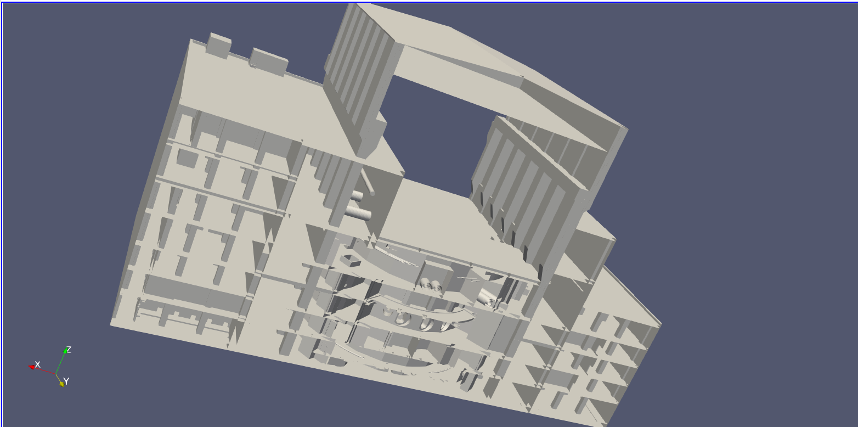
Tokamak Complex

Slide 10
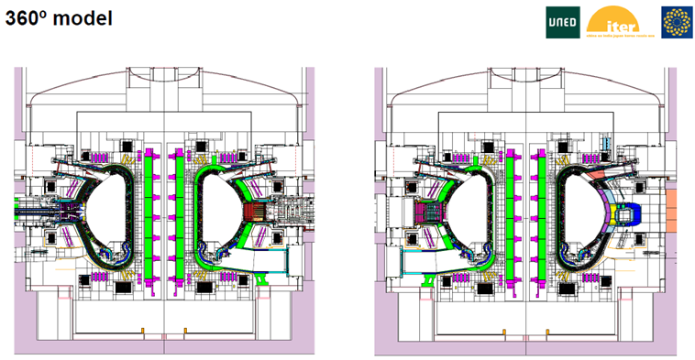
Radiation Transport Simulations
Courtesy Rafael Juarez et al., UNED

Slide 11
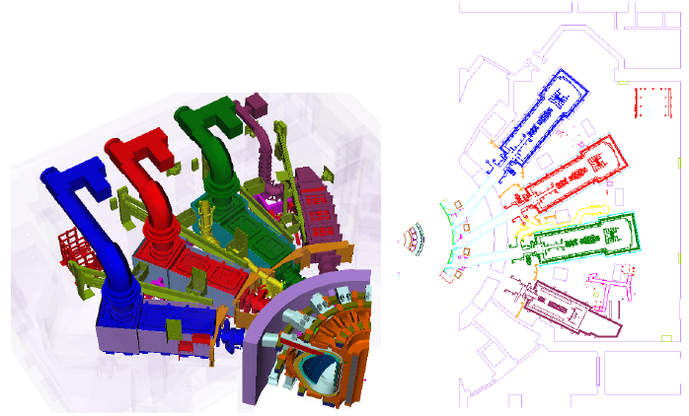
Complexity of Geometry

Slide 12
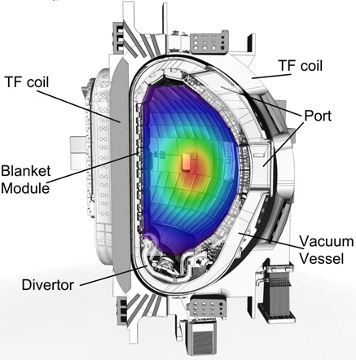
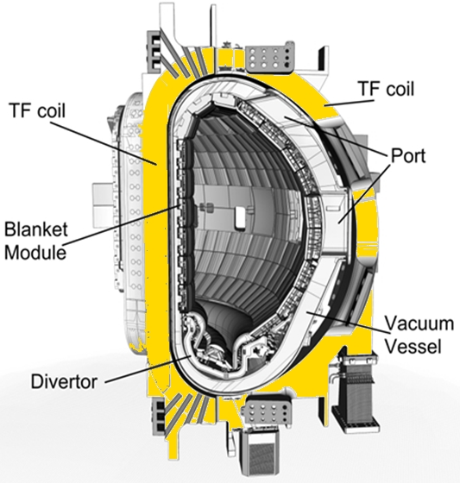
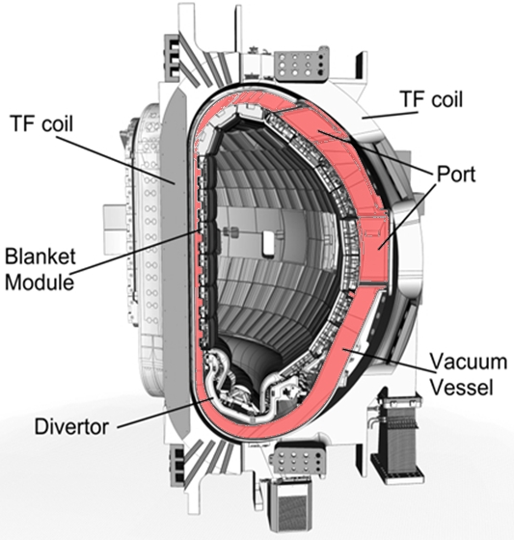
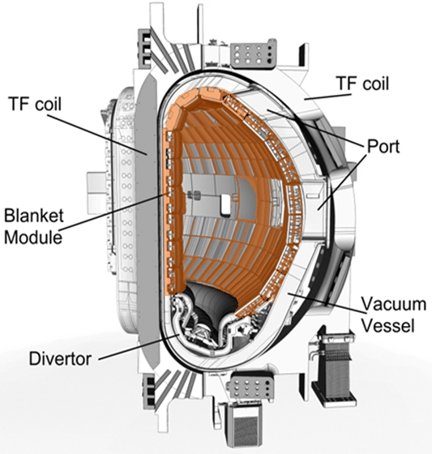
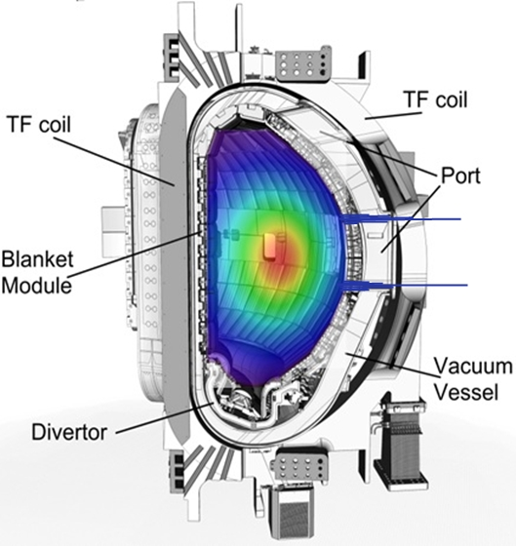
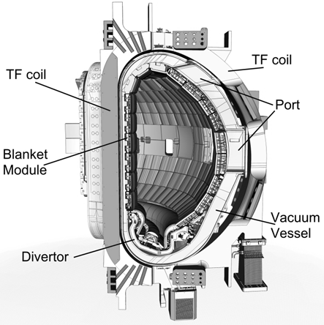
Nuclear responses
TF coil heating
Dose to insulation
Fast neutron flux
VV heating
Damage
Blanket and divertor heating
Module activation
Decay heat
Streaming
Water activation

Slide 13
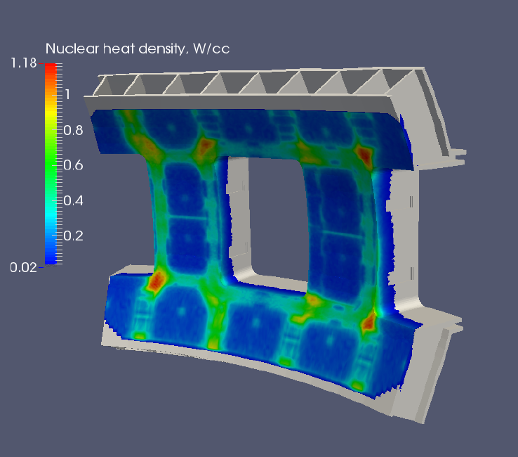
Vacuum Vessel Heating

Slide 14
Activated Water
Activation of Water
  On ITER water will be used to cool the divertor, blanket modules, vacuum vessel, the neutral beam injectors, and the radio-frequency heating and diagnostic systems.
  Activity from water arises because of the production of ¹⁶N and ¹⁷N due to ¹⁶O(n,p)¹⁶N (10.5MeV threshold) and ¹⁷O(n,p)¹⁷N reactions. Tritium and ¹⁹O are also produced.
¹⁶N | Half-life 7.13s | β⁻ 100% γ 6.13MeV (69%), 7.12MeV (5%)
¹⁷N | Half-life 4.17s | β⁻ 100% then delayed neutron (1 MeV) decay (95%) γ 871keV (3.7%)

Slide 15
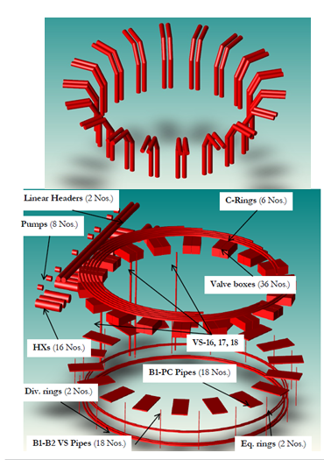
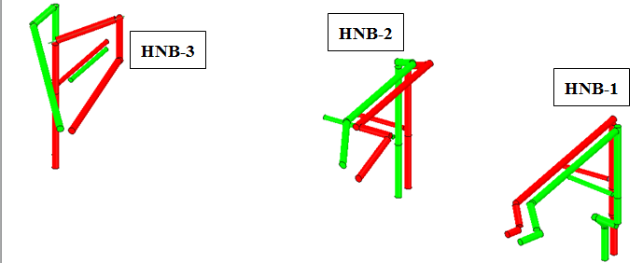
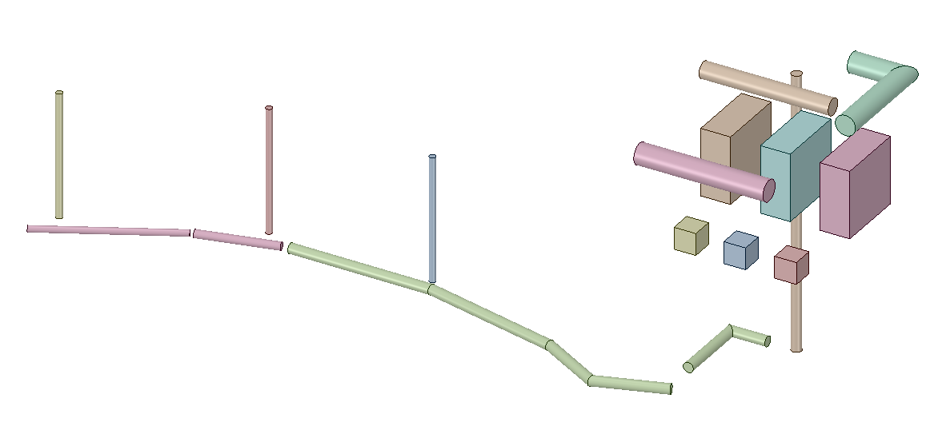
Activated Water
Activated water sources
IBED PHTS
NBI PHTS
In-bioshield
L3-HV Deck
room
Out-bioshield
L3-L4
VVPHTS: In UPC, VS#8, LPC, B2-north gallery and DRT room (B2-B1)

Slide 16
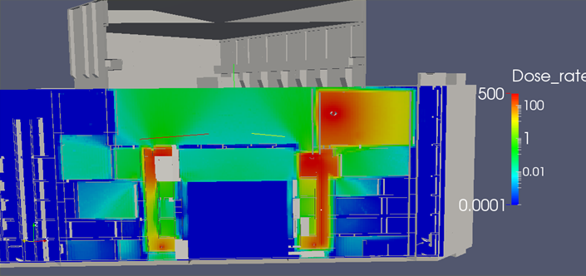
Gamma Dose from Water

Slide 17
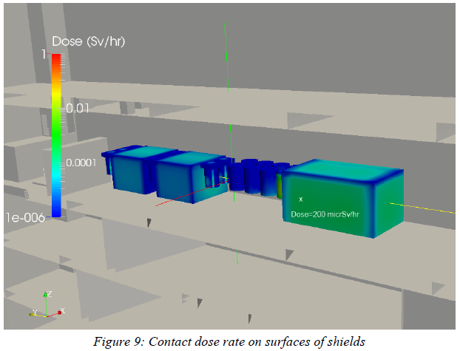
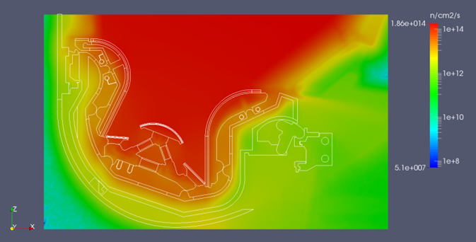
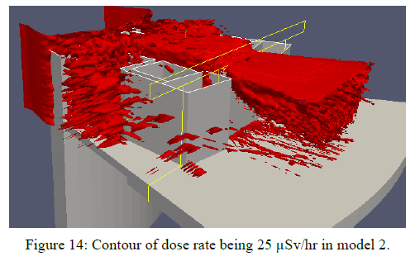
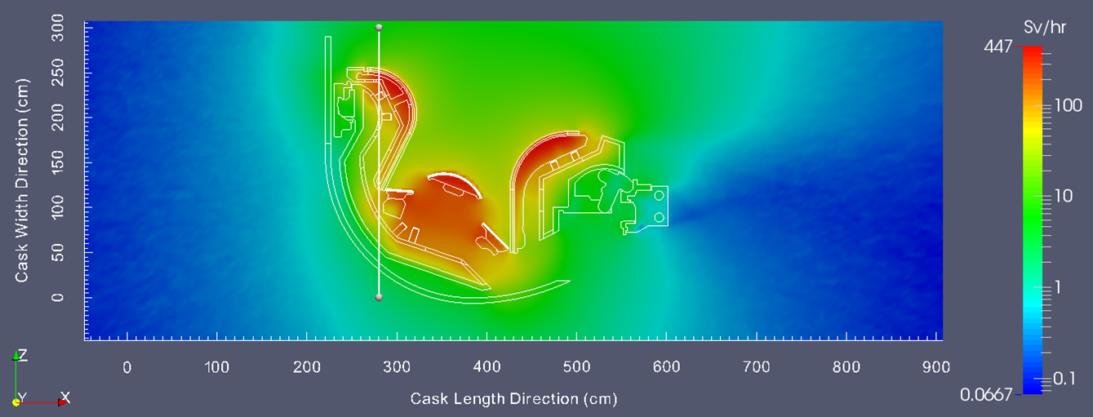
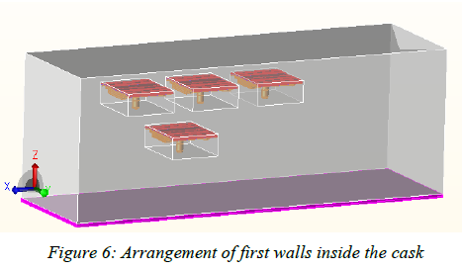
Variety of Radiation Sources
Plasma
Activated water
Activated Blankets, divertor cassettes, port plugs
Activated corrosion products
Activated dust

Slide 18
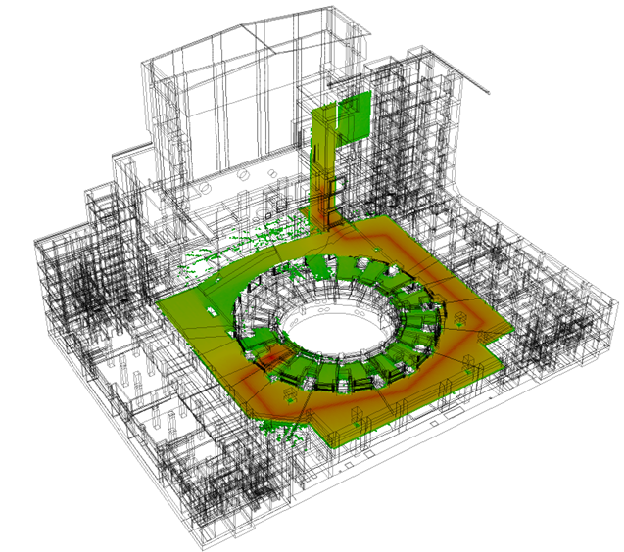
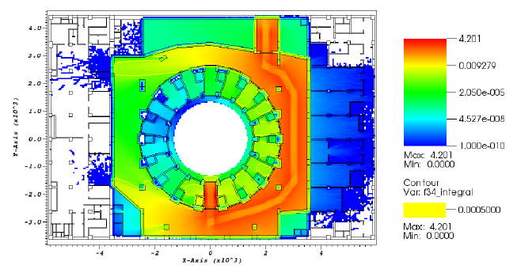
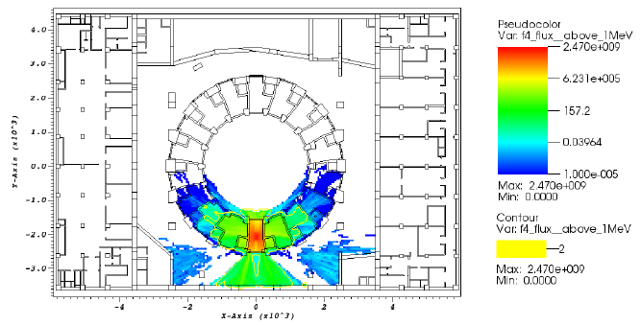
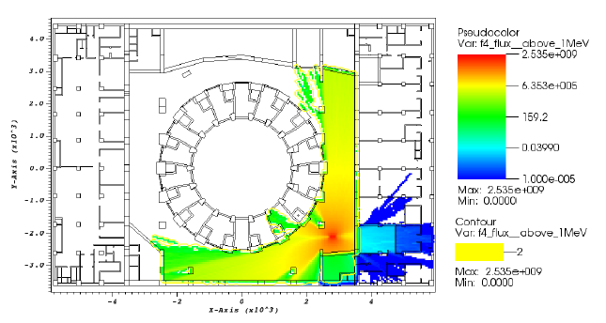
Complexity of Source

Slide 19
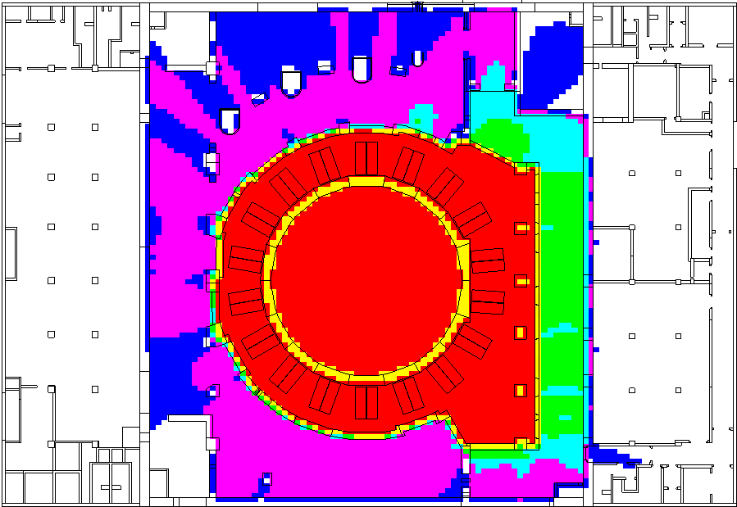
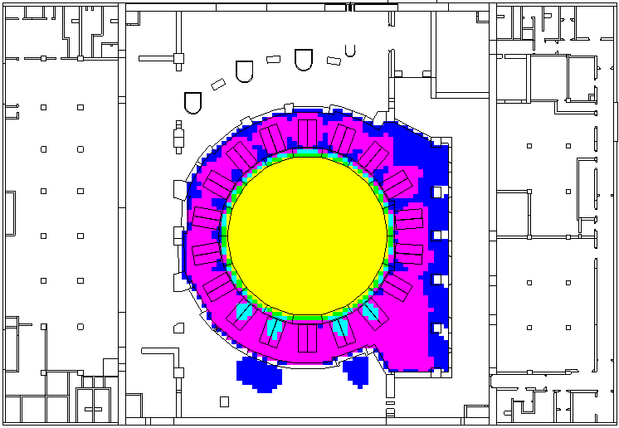
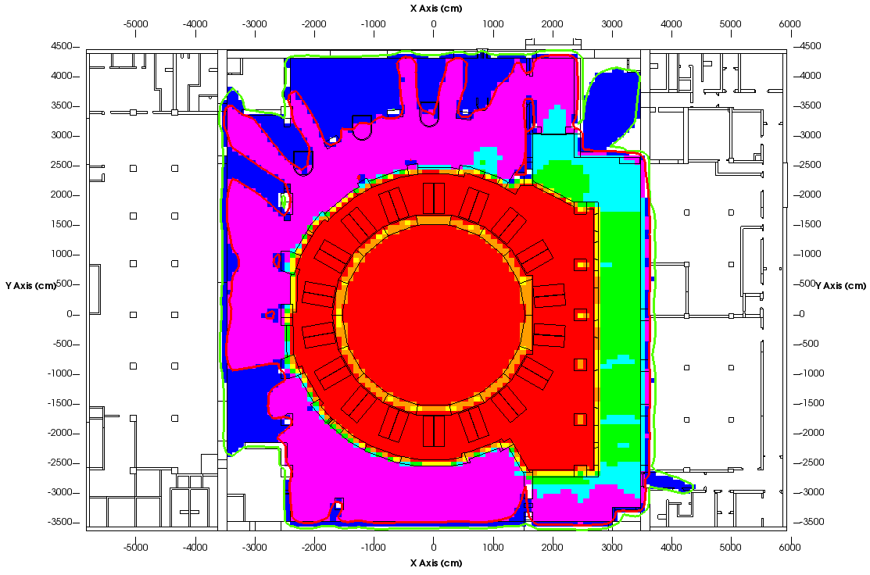
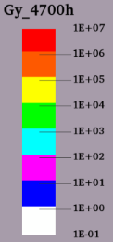
Example: Absorbed dose in Si
Activated water
Plasma
Total
¹⁶N isotope in Activated water is the main source of total ionizing dose (TID) outside bio-shield

Slide 20
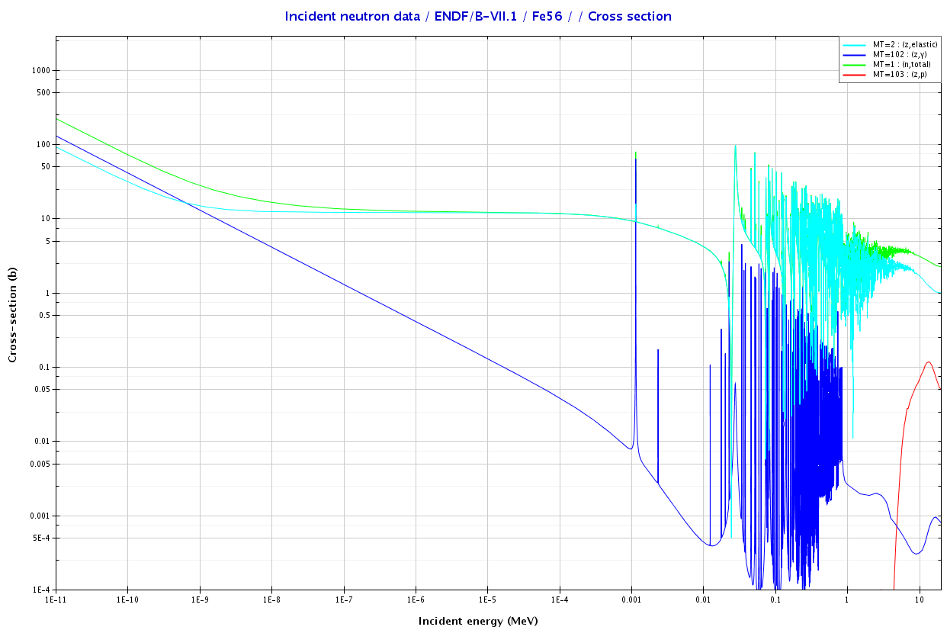

Neutron Activation

Slide 21
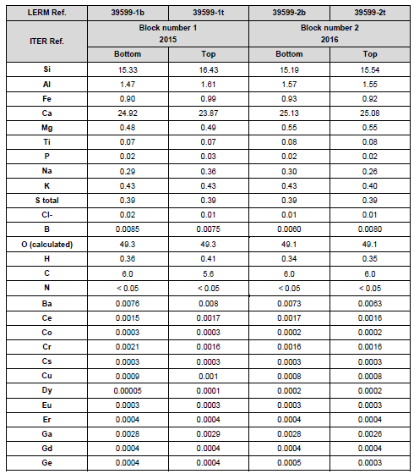
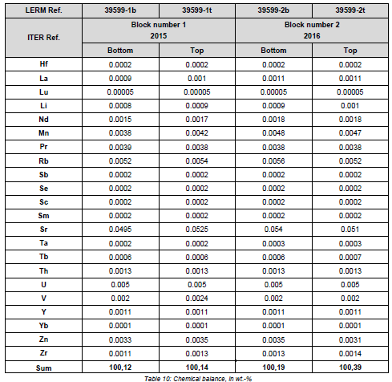
Example: Concrete

Slide 22
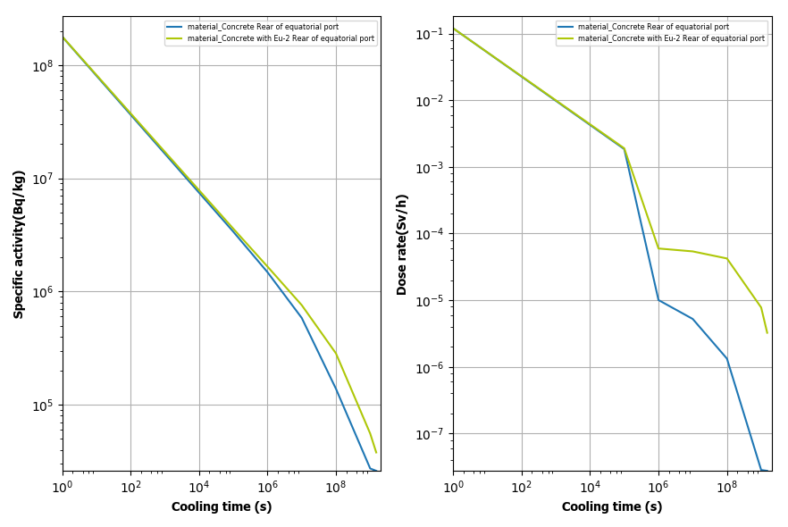
Comparison of dose rates

Slide 23
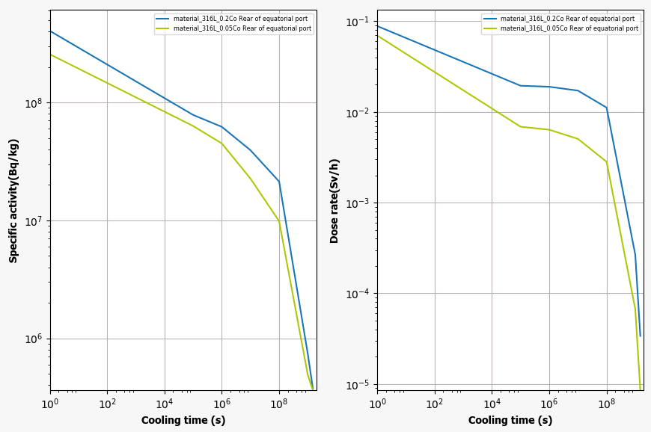
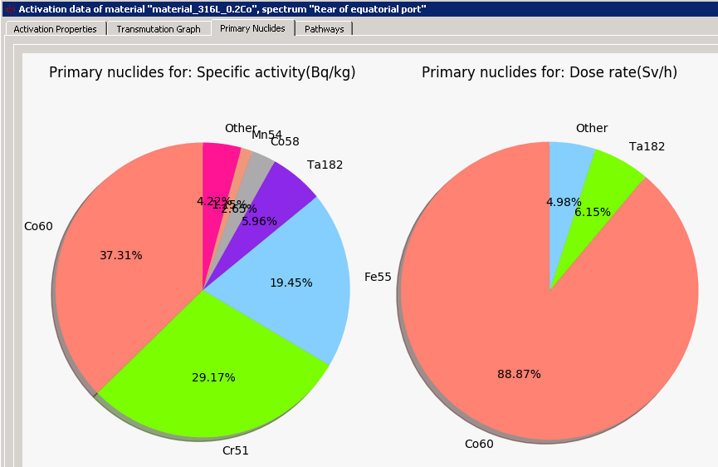
Control of Impurities

Slide 24
Material Transformation
In addition to the production of radio-active isotopes, materials can be transformed under neutron irradiation.
One example is the transformation of gold into mercury. Mercury is incompatible with vacuum.
¹⁹⁷Au + n → ¹⁹⁸Au + γ → ¹⁹⁸Hg
β⁻

Slide 25
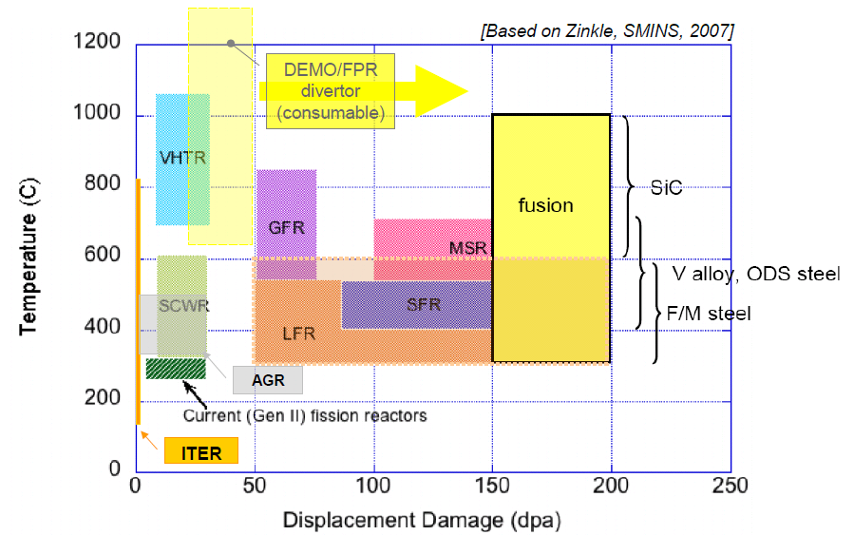
Neutron Damage

Slide 26
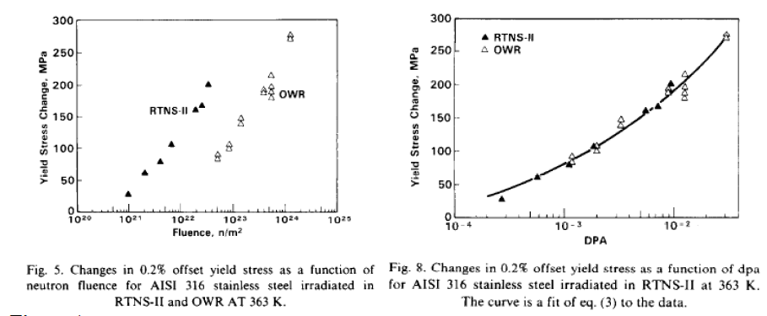
Neutron Damage
Neutron damage is caused by atomic displacement in primarily elastic collisions and gas production (H and He).
This leads to degradation of the mechanical properties of the material (e.g. tensile strength, fracture toughness and fatigue).
Differences in neutron spectrum can be accounted for by using displacements per atoms (dpa) as a correlation parameter at least for low doses)

Slide 27
Radio-active Waste
Details of regulations may vary depending on the host nation and are nuclide specific.
Activation of impurities is critical.
Some nuclides which can effect radio-active waste categorization are listed
Nuclide | Half-life (yrs)
³H | 12.32
³⁶Cl | 3.01×10⁵
⁶⁰Co | 5.271
⁶³Ni | 101
⁹⁴Nb | 2.0×10⁴
^{108m}Ag | 420
¹³⁴Cs | 2.065
¹³⁷Cs | 30.07
¹⁵¹Sm | 90
¹⁵²Eu | 13.54
¹⁵⁴Eu | 8.593

Slide 28
Other Radiation Effects
Most materials are affected by neutron irradiation which can impact their proper operation.
Hydrocarbons degrade
Single particle effects in electronics
Darkening of optical fibres
Radiation induced EMF
Etc….

Slide 29
Safety issues
Activation
  Decay heat
  Occupational radiation exposure (ORE)
  Rad-waste
Damage
  Confinement barriers
  Qualification of safety related components
  Operability of plant

Slide 30
Impacts on Safety
Neutron irradiation cause multiple effects on materials
  Transformation
  Activation
    Radioactivity
    Decay Heat
  Damage (mechanical properties, gas production)
The effects may impact Safety in the following respects:
  Integrity of confinement barrier (damage and decay heat)
  Operation and integrity of safety important components
  Impact on ORE
  Generation and categorization of radio-active waste

Slide 31
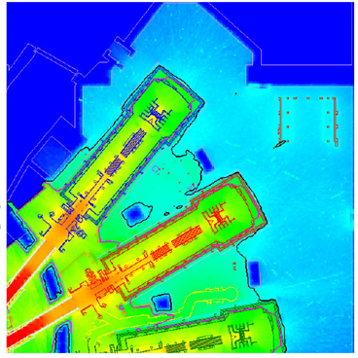
External Exposure

Slide 32
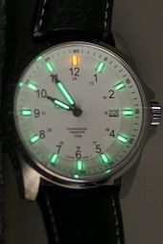
Contamination: Tritium
Radioactive Decay: | β– emitter, E_{max}- 18.6 keV
Specific activity: | 3.7×10¹⁴ Bq/g
Radioactive decay Half-Life: | 12.3 years
Biological removal Half life: | 12 days ( HTO form)
Soft beta emission, not an external radiation hazard
HTO can permeate into the body through intact skin or cuts in skin or
ingestion from the skin by water/food route.

Slide 33
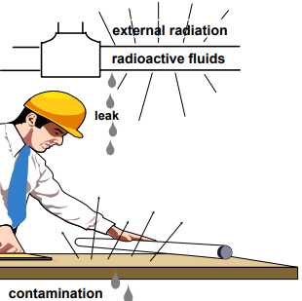
Activated Corrosion Products
Radionuclide
Composition
ACP deposits contribute to both external and internal exposures to maintenance workers
Major contributor to worker dose in maintenance – ⁶⁰Co gamma ( ̴75-80 % of total dose)
Notes:
Add notes here

Slide 34
Summary & Conclusions
ITER brings us a step closer to a fusion reactor
The nuclear challenges are being addressed now
Further issues are likely to be uncovered and will have to be met in the realization of fusion as a viable source of energy.

Slide 35
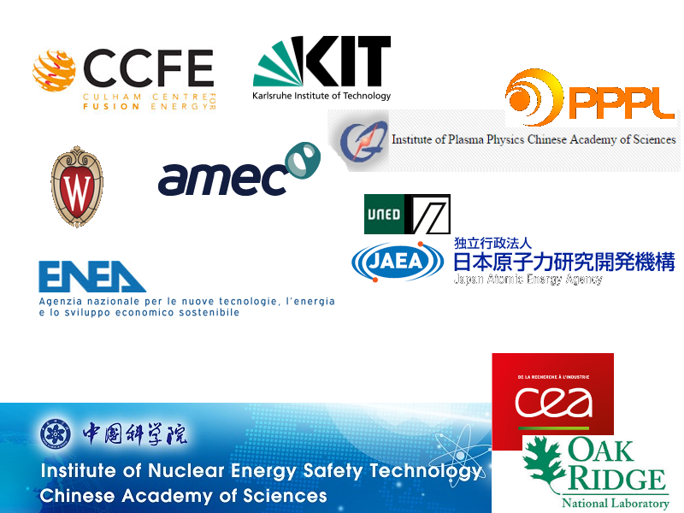
Thanks

